Slide 1

Weather Guide
Fozi Abo Zhaya
Jasmen Mura

Slide 2
Introduction
Our project focuses on developing an advanced long-range weather forecasting application that empowers users with accurate, reliable predictions for better planning. By leveraging high-resolution ERA5 data and cutting-edge machine learning, our project aims to revolutionize long-term weather forecasting.

Slide 3

Problem Statment
The unpredictability of weather patterns challenges sectors like agriculture, travel, and event planning, which rely on long-range forecasts. Current forecasting models offer predictions only up to 10 days in advance, leaving a gap for those needing insights weeks or months ahead. This gap results in inefficiencies, increased risks, and missed opportunities for effective planning and resource management.

Slide 4

Exisitng Solutions
The Weather Channel
Advanteges:
Comprehensive Coverage
Severe Weather Alerts
How Our App Is Better:
Focus on Long-Range Forecasting
Probabilistic Forecasting
Disadvanteges:
Limited Long-Range Forecasts
Advertisements

Slide 5
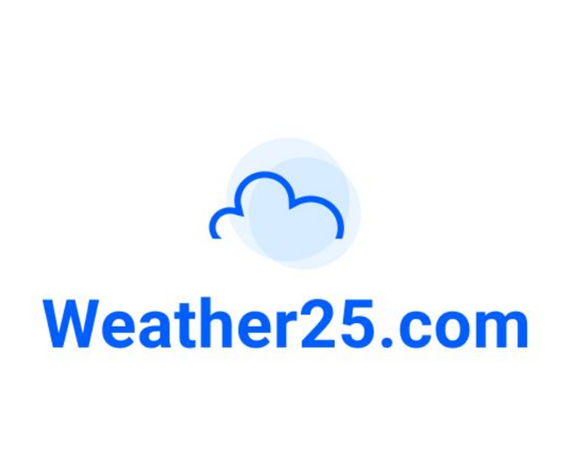

Exisitng Solutions
2. Weather25
Advanteges:
Global Coverage
Simplicity
How Our App Is Better:
Extended Forecast Range
Advanced Features
User Customization
Disadvanteges:
Limited Forecasts Range
Basic Features

Slide 6

Exisitng Solutions
3. WeatherStack
Advanteges:
Real-Time and Historical Data
Global Coverage
Easy Integration
How Our App Is Better:
User-Friendly Interface
No Subscription Barrier
Comprehensive Forecasting Tool
Disadvanteges:
Subscription Costs
Requires Technical Knowledge
Dependency on API

Slide 7



Our Solution
Focus on Long-Range Forecasts
Comprehensive and Detailed Data
Probabilistic Forecasting
While other apps focus primarily on short-term or medium-term forecasts, your app fills a critical gap by providing accurate and detailed forecasts far beyond the typical 10-14 days.
High-Resolution ERA5 Data Integration
The use of ERA5 data provides users with highly accurate and detailed forecasts based on historical observations and advanced modeling.
Multiple Outcome Forecasts
Our app provides a much richer picture of future weather conditions.

Slide 8
Challenges
Ensuring Real-Time Data Accuracy.
Handling Large Datasets
Difficulty in Generating a Unique Idea
Complexity of User-Friendly Design

Slide 9
Tools Used

Slide 10
Era5 Reanalysis Data
What Is ERA5?
Comprehensive global climate and weather dataset.
Provides historical and high-resolution data for accurate long-range forecasts
Offers hourly estimates of various atmospheric, land, and oceanic variables since 1940.

Slide 11
K-Means Clustering Algorithm
What Is K-Mean Clustering?
Machine learning algorithm for grouping similar data points into clusters.
Groups historical weather data into distinct patterns or clusters.
Helps in identifying recurring weather patterns to predict future conditions.

Slide 12
Probabilistic Forecasting Model
What Is Probabilistic Forecasting Model?
A model that predicts multiple possible weather outcomes with associated probabilities.
Provides users with a range of weather scenarios instead of a single deterministic prediction.
Enhances decision-making by showing the likelihood of various weather conditions.

Slide 13
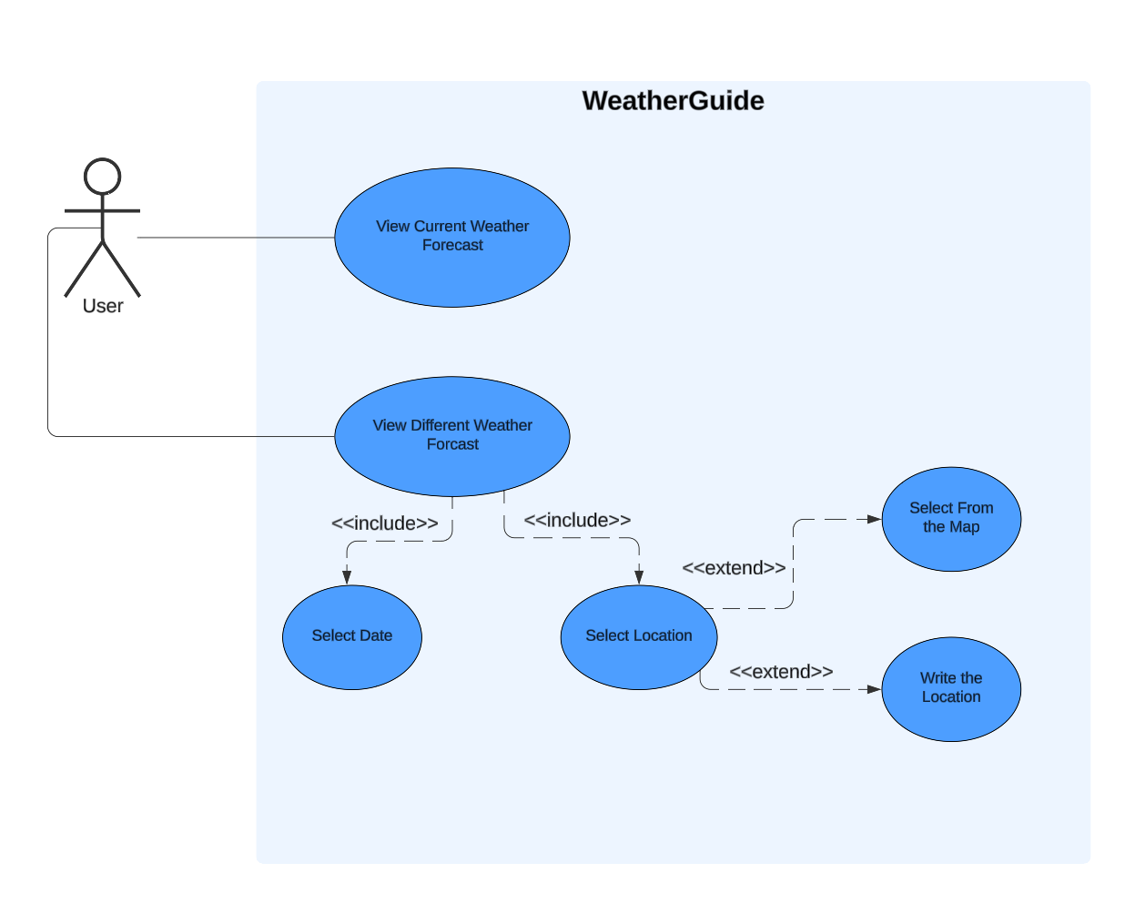
Use Case Diagram

Slide 14
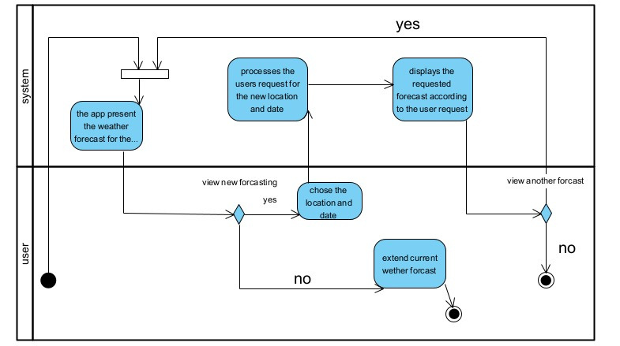
Activity Diagram

Slide 15
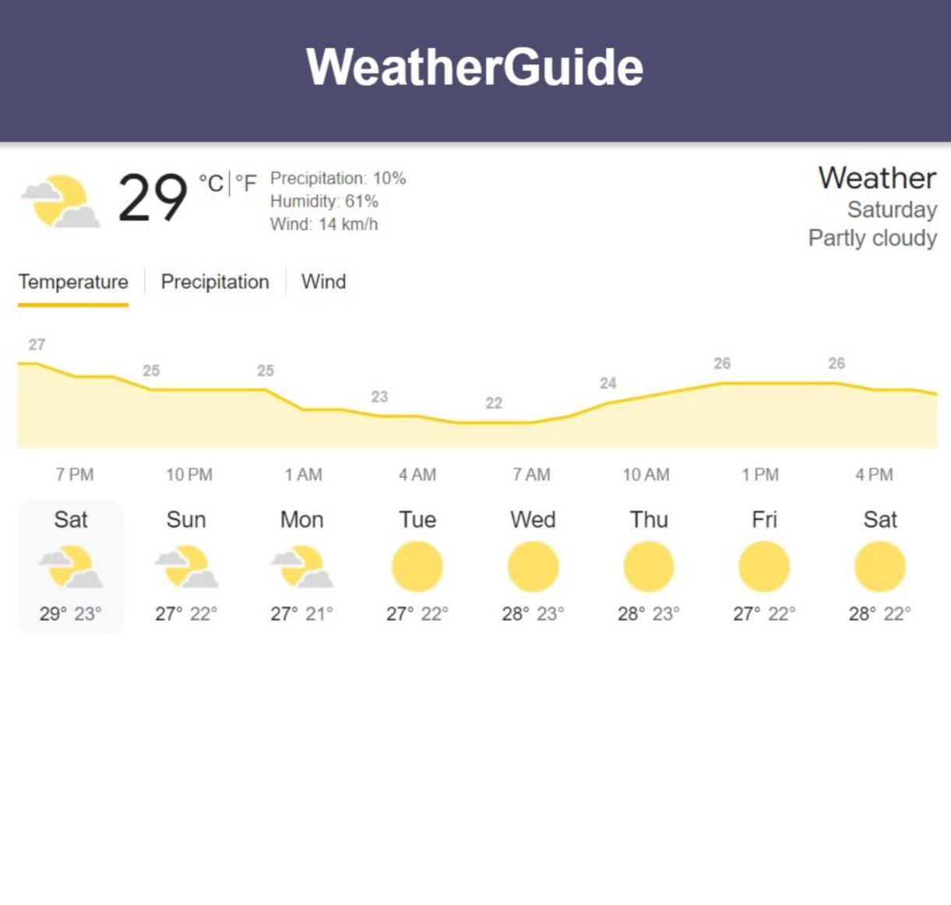
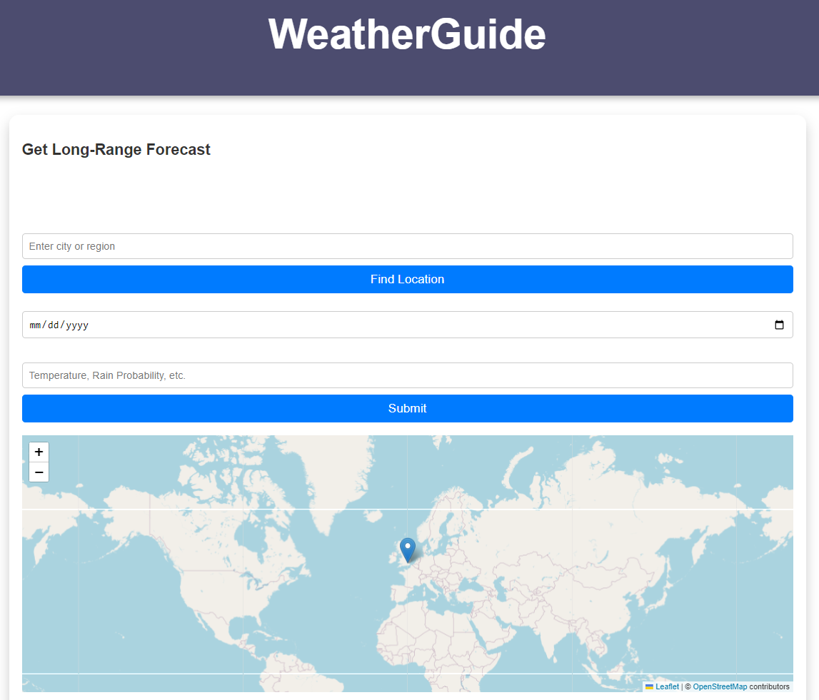
GUI

Slide 16
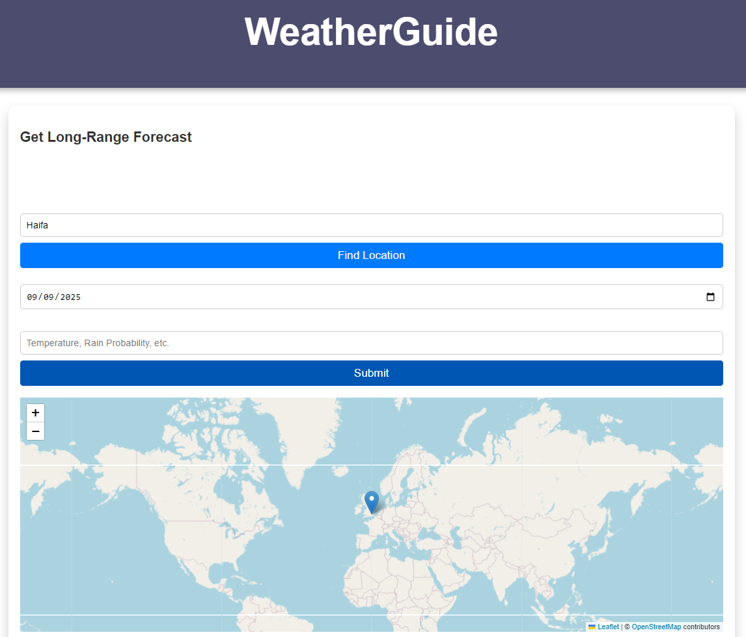
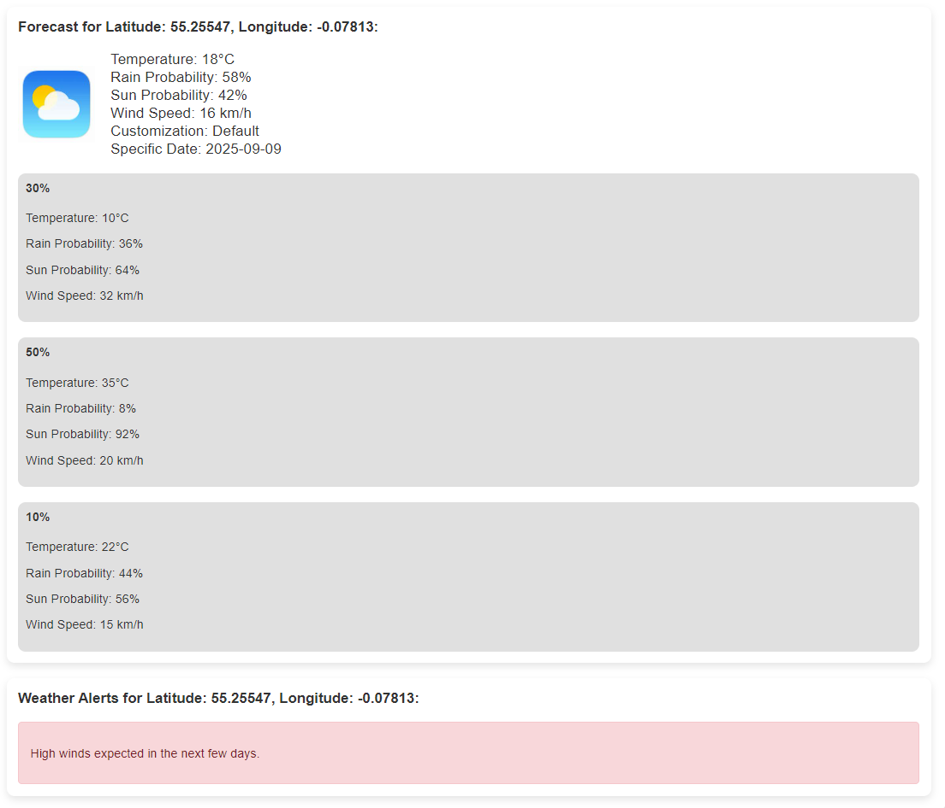
GUI

Slide 17
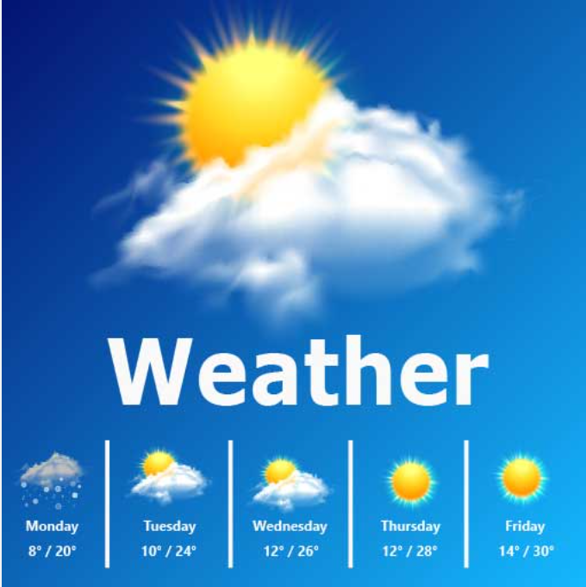
Conclusion
Transforming Long-Range Forecasting:
Our Weather Forecasting Application represents a significant advancement in long-term weather prediction, empowering users to make informed decisions weeks or even months in advance.
Harnessing Cutting-Edge Technology:
By integrating ERA5 reanalysis data, machine learning algorithms, and probabilistic forecasting models, we deliver highly accurate and detailed weather predictions.
Enhancing Planning and Risk Management:
Beyond offering reliable forecasts, our system supports critical sectors like agriculture, travel, and event planning, helping reduce risks and optimize operations, contributing to more resilient and prepared communities.

Slide 18
Thank you

